Slide 1
Economics 144 Economic Forecasting
Lecture 11
Forecasting with Regression Models
Dr. Randall R. Rojas

Slide 2
Today’s Class
Conditional Forecasting Models and Scenario Analysis
Uncertainties in Confidence Intervals for Conditional Forecasts
Unconditional Forecasting Models
Lags
Distributed
Polynomial Distributed
Rational Distributed
Regressions with
Lagged Dependent Variables
ARMA Disturbances
Transfer Function Models
Vector Autoregressions (VAR)
Predicative Causality
Impulse-Response Functions and Variance Decomposition
R Example

Slide 3



Regression Model
Regression Models (a.k.a. Causal or Explanatory Models): Example, consider a linear model
and
Conditional Forecasting Model: Model used for forecasting e.g., y conditioned on other variables.
Scenario Analysis (or Contingency Analysis): Forecast y conditional on an assumed future value of x. Let x* = h-step-ahead value of x →
Endogenous
Variable
Exogenous or
Explanatory Variables
(h-step-ahead conditional forecast for y)
(conditional density forecast)

Slide 4
Uncertainties in Confidence Intervals for Conditional Forecasts 1 of 2
Forecasts are subject to error. In the case of scenario forecasts, we can identify at least 3:
Specification Uncertainty: Due to model simplifications.
Innovation Uncertainty: Due to unknown future innovations when the forecast is made.
Parameter Uncertainty: Due to estimation of the model coefficients.
In the case of the conditional forecasting model, we can quantify the innovation and parameter uncertainties.

Slide 5


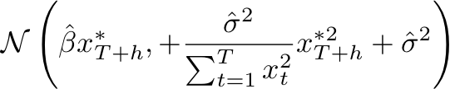




Uncertainties in Confidence Intervals for Conditional Forecasts 2 of 2
Consider the Linear model: where x has zero mean. Want to predict at →
and
Density Forecast

Slide 6


Unconditional Forecasting Models
Forecasting the right-hand-side Variables Problem: To get an optimal unconditional point forecast for y, we need to insert the optimal point forecast, x_{T+h, T} .
Unconditional Forecast:
A Solution: Fit an autoregressive model to x, forecast x(i.e., ), and then use the forecast of x to forecast y.
Better Solution: Estimate all the parameters simultaneously by regressing y on x_{t-h}, x_{t-h-1}, …
→ We can forecast e.g., 1-step-ahead using the model:
Model for y not for x.

Slide 7
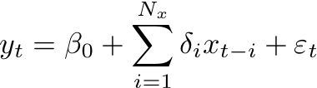
Distributed Lags 1 of 2
We can generalize the forecasting model
to the Distributed Lag Model:
In this model, y depends on a distributed lag of past x’s. δ_{i} = lag weights, and their pattern is the lagged distribution. N_{x} = number of lags of x.
Polynomial Distributed Lags: If N_{x} is too large, we can instead use a low order polynomial lag distribution. The benefits are that you can improve your forecasting performance with a sophistically simple model (considerably fewer parameters than N_{x}+1).

Slide 8

Distributed Lags 2 of 2
Rational Distributed Lags: Promote smoothness in the lag distribution but are less restrictive than the low-order-polynomial. For example, if A(L) an B(L) are low-order polynomials in the lag operator, then
Therefore,
Both, lags of x and y are now present

Slide 9
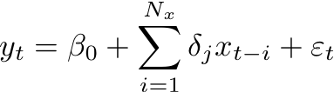

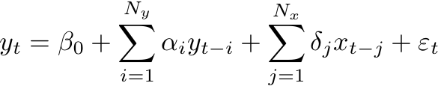

Regressions with Lagged Dependent Variables Regressions with ARMA Disturbances
Given , we left out the past of y.
A better model:
Alternative model:
Distributed Lag Regression model with
Lagged dependent variables.
Distributed Lag Regression model with ARMA disturbances.

Slide 10

Regressions with Lagged Dependent Variables Regressions with ARMA Disturbances
In general, distributed lagged regressions with lagged dependent variables or ARMA Disturbances, are both special cases of Transfer Function Models.
Transfer Function:
Notice that ARMA models are a special case, A(L)=0.

Slide 11
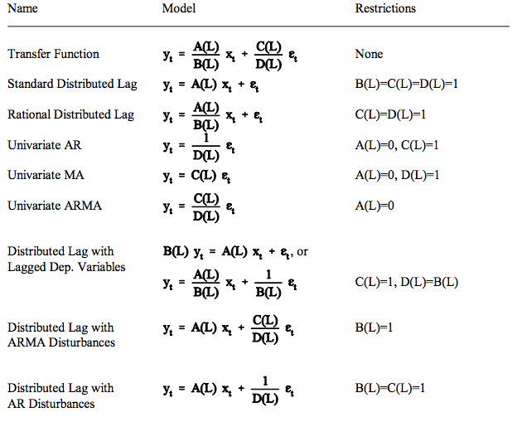
Transfer Function Models

Slide 12



Vector Autoregressions (VAR)
VAR(p): An N-variable vector autoregression of order p. We estimate N different equations. In each equation, we regress the relevant l.h.s variable on p lags of itself, and p lags of every other variable.
Vector autoregressions allow for cross-variable dynamics.
Example: Two variables (y₁ and y₂) VAR(1).
and

Slide 13

Impulse-Response Functions (VMA) and Variance Decompositions 1 of 3
Impulse-Response Functions (IRFs): Describe how the economy reacts over time to exogenous impulses, which economists usually call 'shocks', and are often modeled in the context of a vector autoregression.
Strategy: In the MA representation, we can normalize the coefficients of ε_{t} to values different form unity.
Let b_{i}’ = b_{i}m and ε_{t} = ε_{t}/m. If m =1→ MA, however, we can try m = σ instead.

Slide 14



Impulse-Response Functions (VMA) and Variance Decompositions 2 of 3
For the multivariate case: How does a unit shock to ε_{i} affect y_{j}, now and in the future, for all combinations of i and j ?
For the VAR(1) bivariate case, assuming y₁is ordered first.

Slide 15





Impulse-Response Functions and Variance Decompositions 3 of 3
Algorithm (for the bivariate case):
Normalize the system for e.g., y₁.
Compute the response of y₁ to a unit normalized innovation to y₁, { }.
Compute the response of y₁ to a unit normalized innovation to y₂, { }.
Compute the response of y₂ to a unit normalized innovation to y₂, { }.
Compute the response of y₂ to a unit normalized innovation to y₁, { }.
Note: { } = Impulse Response Functions

Slide 16
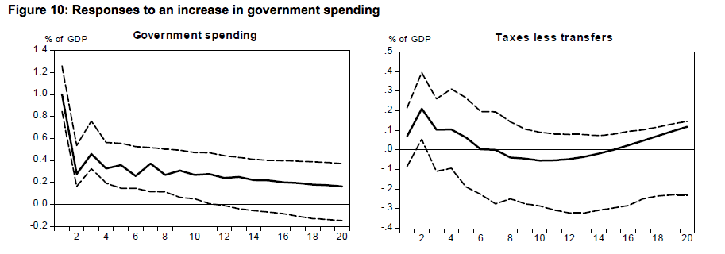
IRF: Response to a positive spending shock (article link) 1 of 3
The government spending shock is highly persistent
and turns insignificant after 2.5 years.

Slide 17
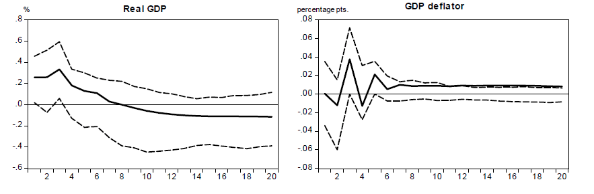
IRF: Response to a positive spending shock (article link) 2 of 3
The GDP response turns slightly negative after 2 years
possibly due to the persistently higher level of real interest rates.

Slide 18
IRF: Response to a positive spending shock (article link) 3 of 3
Net taxes respond positively to the spending increase with the response peaking in the second quarter.

Slide 19
For Next Class
Readings about today’s class:
Chapter 11
Review Exercises / Problems:
Chapter 11: 2, 3, 5, 6, 8
Readings for next class:
Chapter 12

